Slide 1


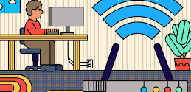

CNS PROJECT
TEAM MEMBERS:​
S.J SUMANTH(2010030377)​
K. SREEVARUN(200030451)​
E. PAVAN SAI(2010030538)​
E. SHIVA GOUD(2010030542)​

Slide 2

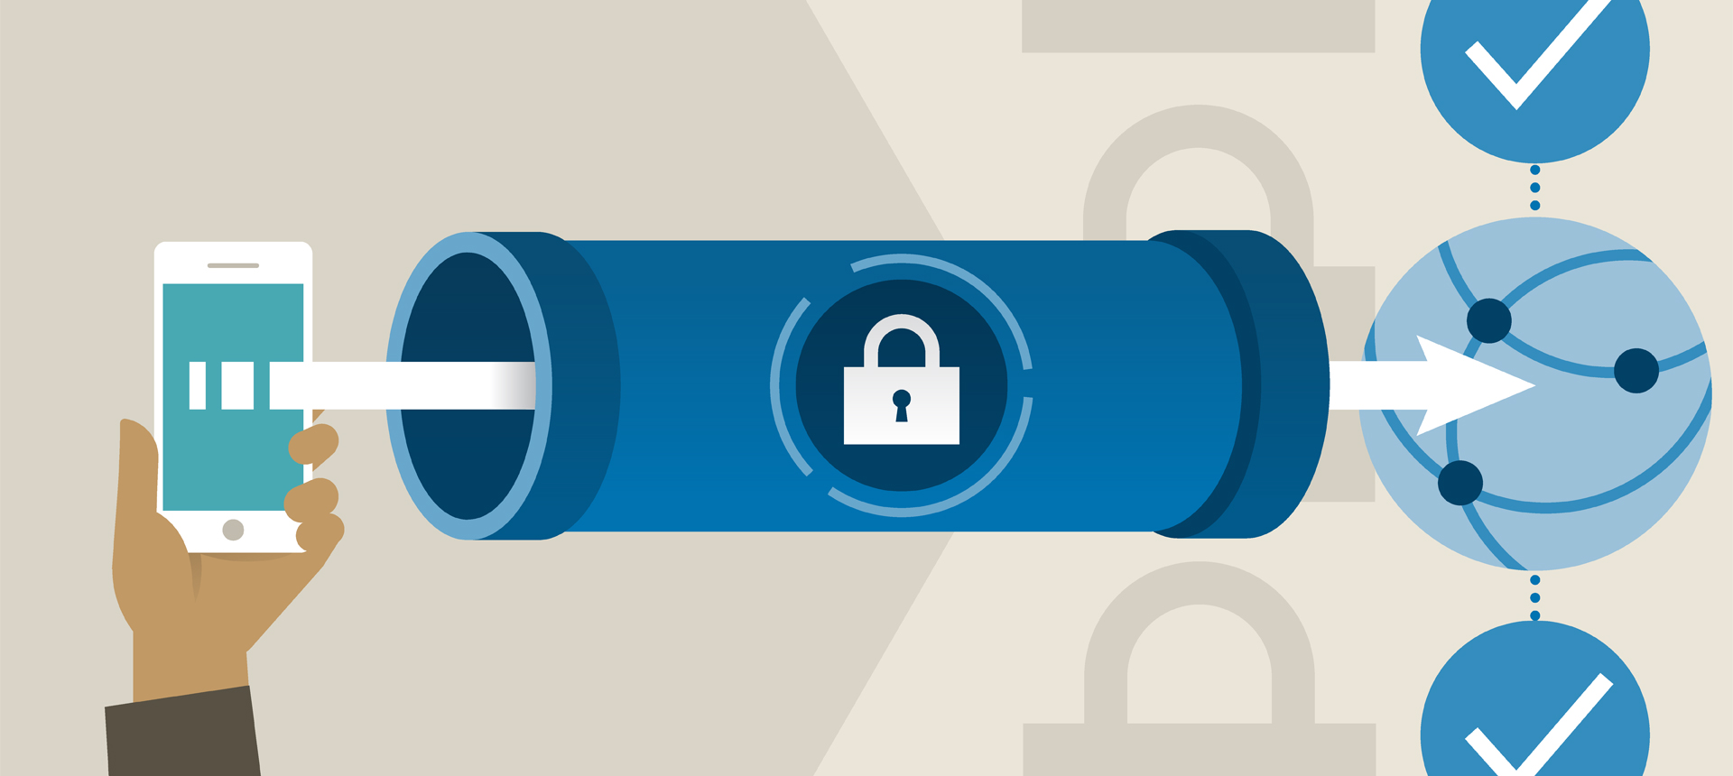
IPSEC BASED Virtual private network FOR A COMPANY

Slide 3
Outline:
Abstract
Introduction
Flow Chart
Methodology
Implementation

Slide 4

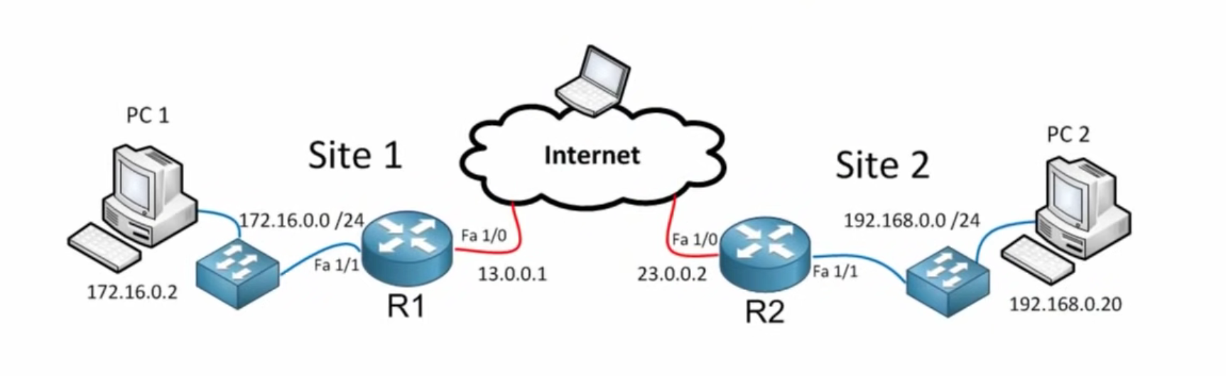
Abstract
Nowadays, organization do all they can to maintain control and help protect their corporate networks and its information asset from cyber threats. However, they heavily rely on the users as the first line of defense who sometimes are not compliance to network security regulations enacted. Therefore, it is vital for the company to ensure cybersecurity awareness and possibly security implications that can emanate from cyberattacks such as malware and network intrusions.
In addition to existing policy and network security mechanism and services, an IPsec VPN has been proposed as one of the most fundamental data security practices to ensure data privacy and protect systems effectively.
IPsec VPN authenticates and encrypt the virtual connections between two nodes. The use of IPsec protocols to implement VPN can help to protect against system vulnerabilities such as IP spoofing, session hijacking, traffic sniffing. Therefore, implementing security controls to provide confidentiality, integrity and availability.

Slide 5

Introduction:
A virtual private network (VPN) gives you online privacy and anonymity by creating a private network from a public internet connection.
VPNs mask your internet protocol (IP) address so your online actions are virtually untraceable. Most important, VPN services establish secure and encrypted connections to provide greater privacy than even a secured Wi-Fi hotspot.
VPN is widely used since it provides secure transmission of data packets at the IP layer using authentication and encryption

Slide 6
START
STOP
success
true
Open cisco
Packet tracer
Ping
Reply Found
Implement the topology
Tunnel Activation
false
Request timed out
Assign the Ip address to all the routers
Mapping
Setup ACL
(Access list permission)
Crypto IPsec
transform-set
Flow Chart
ISAKMP
policy
IKE Negotiation

Slide 7

Methodology
We are using cisco packet tracer for Implementing this project.
The IPsec VPN configuration:
1. Setup an ACL that will specify which interesting traffic will be allowed to pass through the tunnel.
2. Setup Phase 1 of the IPSec Tunnel. In this part, we define the ISAKMP policy and specify that we will use a preshared key. This is also defined in this case.
3. Next, we setup phase 2 of the IPSec Tunnel (IPsec Transform-set). This is where the IKE negotiation takes place. We will be using 256 bit AES encryption with hash message authentication code providing confidentiality, integrity and authentication.

Slide 8
Methodology
The IPsec VPN configuration:
4. All we need to do next is to tie Phase 1 and Phase 2 together by defining the crypto map
5. We then activate IPSec on the outbound interface by applying the crypto map to the interface.
6. For the tunnel to comeuppance, we need to start pings through the tunnel. Attempt pinging across from Laptop0 to Laptop1. The pings may initially fail, but if all configuration is accurate, the pings should succeed after a couple of tries.
7.Finally we need to verify by running the following commands:
!R1
show crypto ipsec sa
!R3
show crypto ipsec sa

Slide 9

Implementation

Slide 10
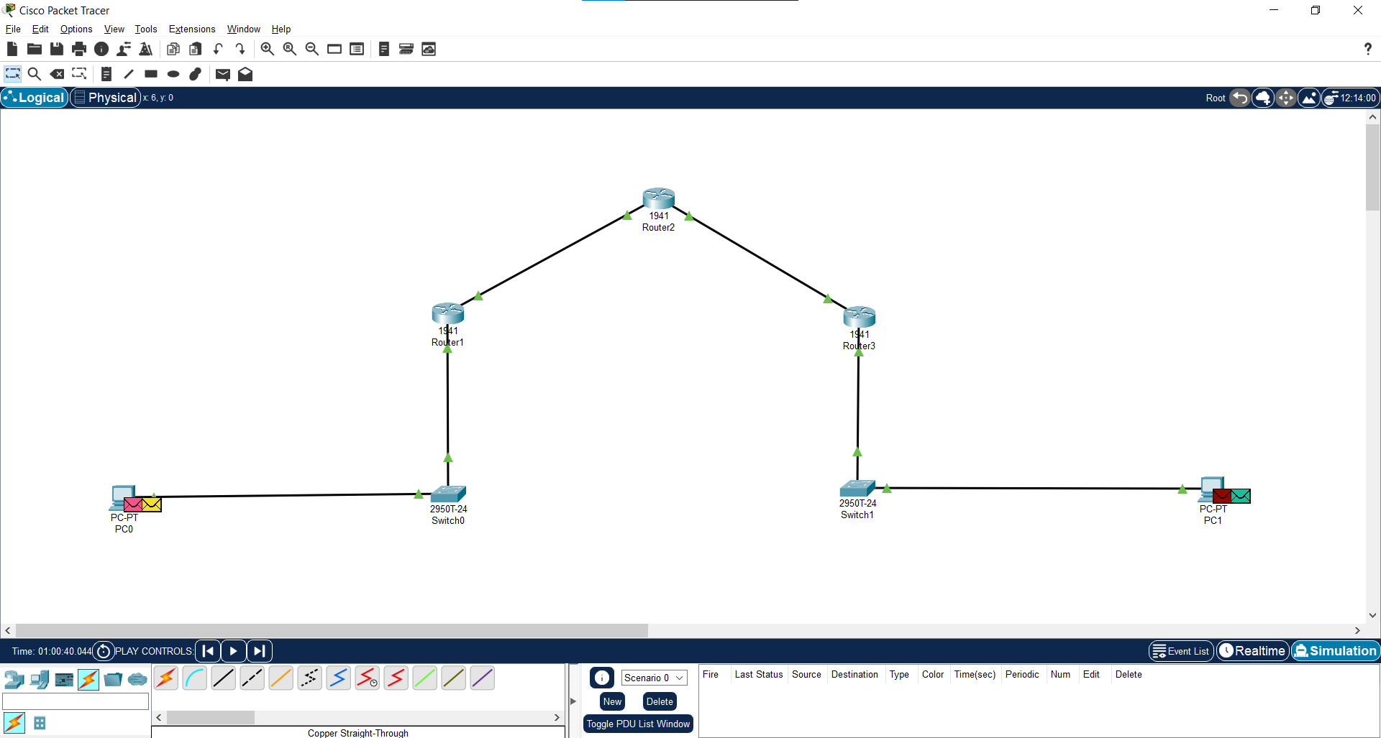

Slide 11
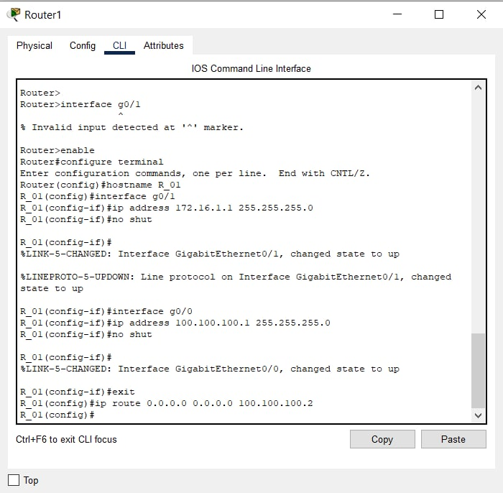
Setting up Routers

Slide 12
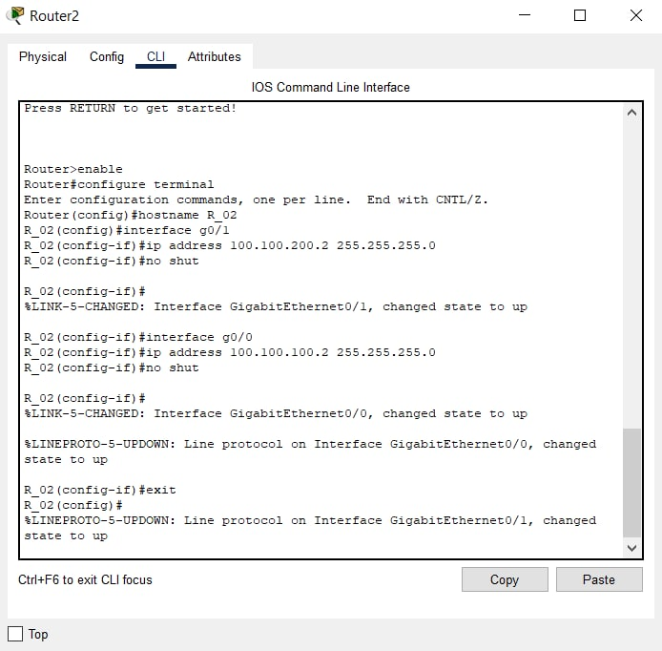
Setting up Routers

Slide 13
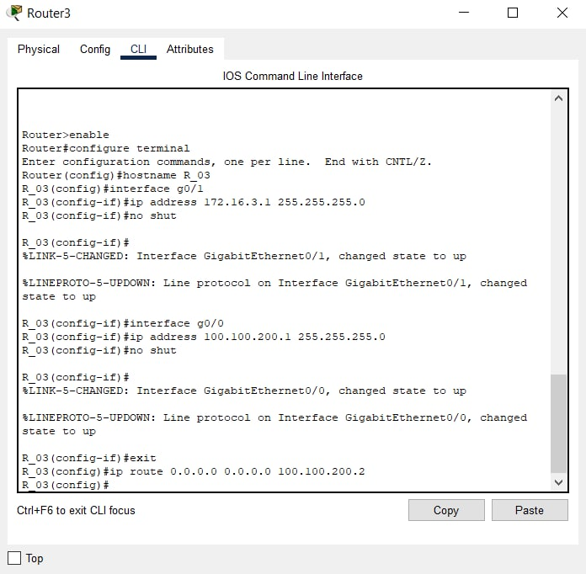
Setting up Routers

Slide 14
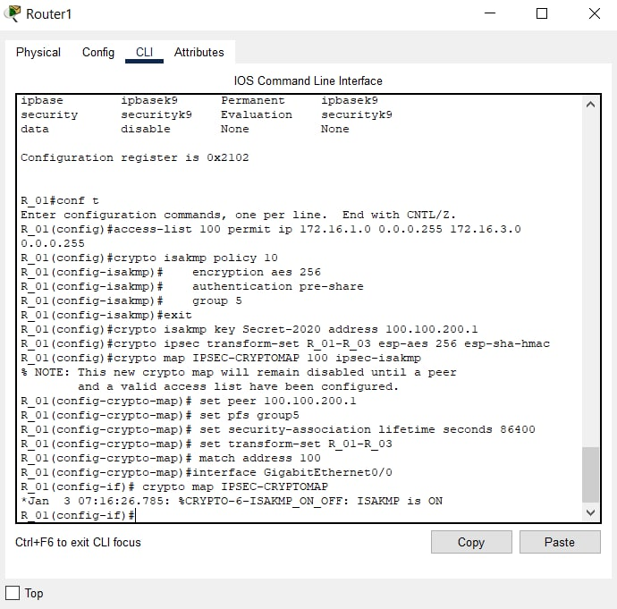
Configuring IPSEC Tunnel

Slide 15
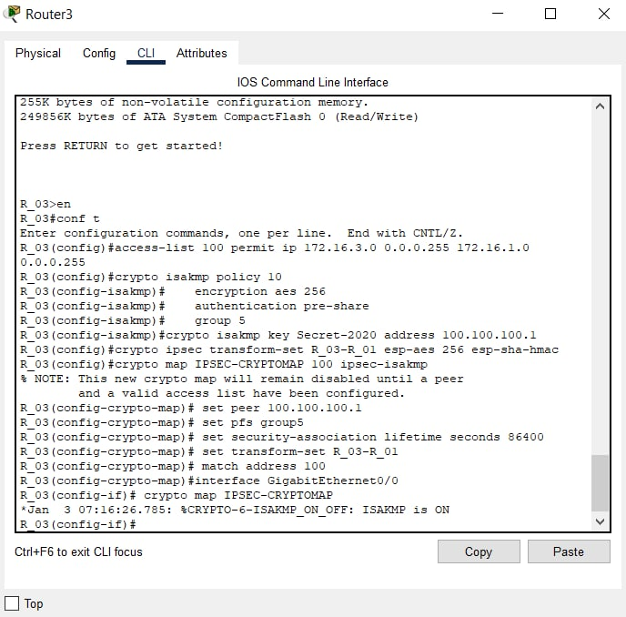
Configuring IPSEC Tunnel

Slide 16
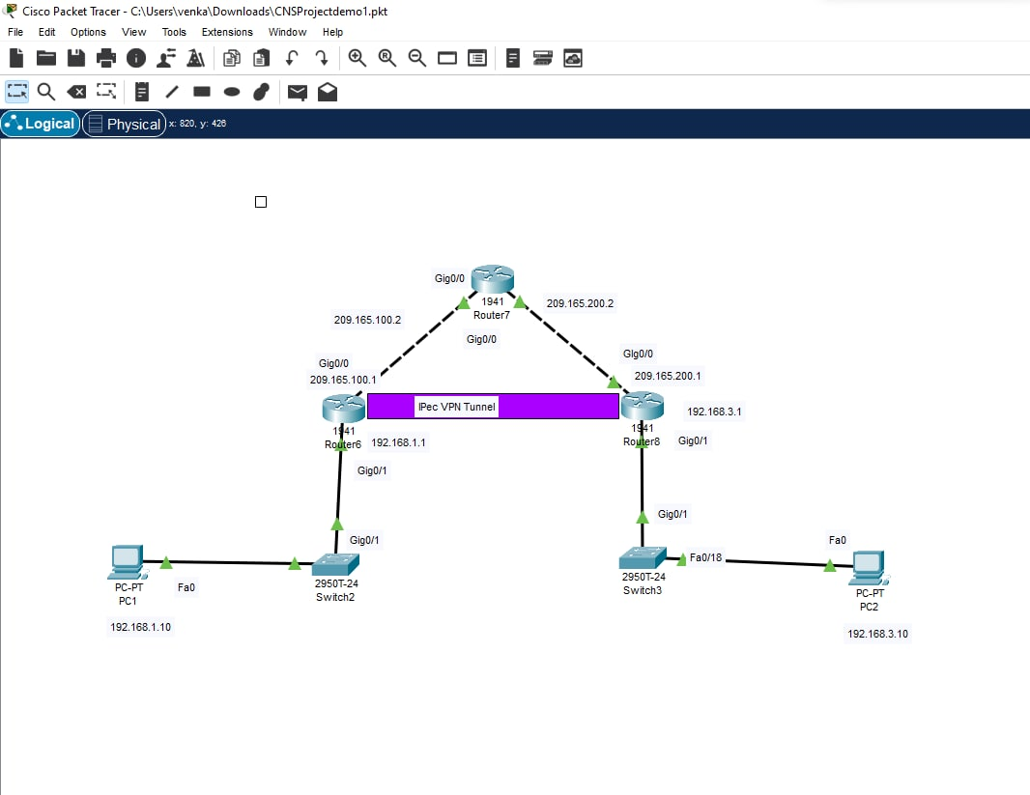

Slide 17

Work in Progress

Slide 18
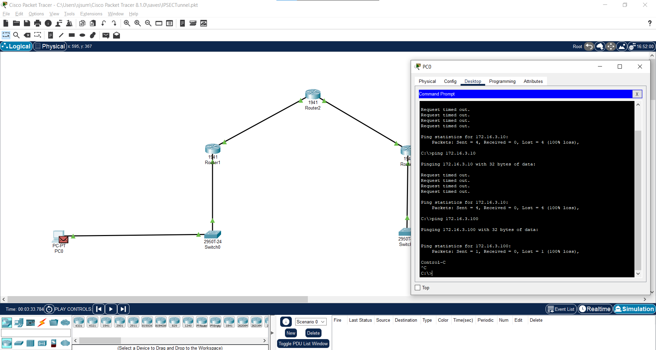

Slide 19


